Slide 1




ASU ASCEND Symposium
Electrical:
David Rodriguez
Anyell Mata
Programming:
David Lopez
Evan Nikitin
Mechanical:
Ben Weber
Jacob Dike
Support:
Surya Madan
Meilyn Guas Perez
Team Lead: Genevieve Cooper
2021 - 2022
Notes:
Add location and date

Slide 2

Goals
Atmospheric Profiling
Data Collection & Storage
Learn about Cloud Formation
Capturing Video
Payload Stabilization

Slide 3
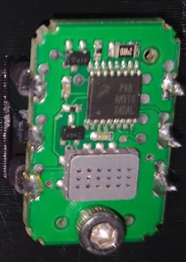
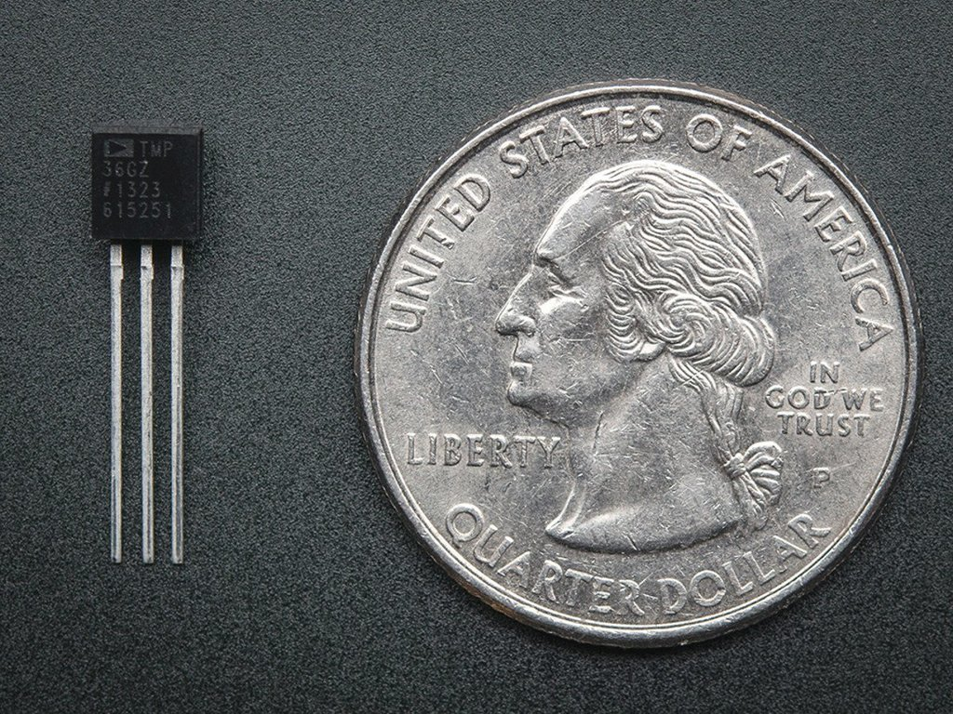
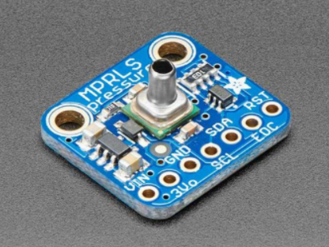
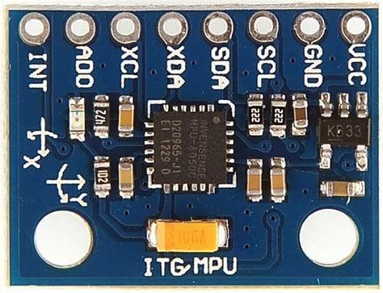
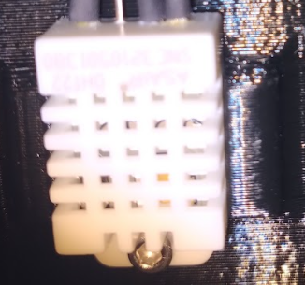
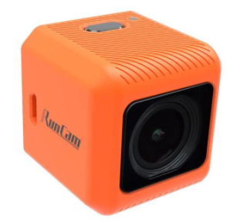
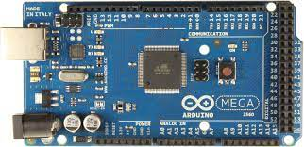
Fall Semester Sensors and Components
AM2303 Humidity
MPRLS Pressure
MPU-6050 Accelerometer
Run Cam 5 Orange
SGP30-2.5K VOC
2 TMP36
Arduino Mega
Notes:
Add mega

Slide 4
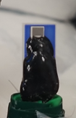
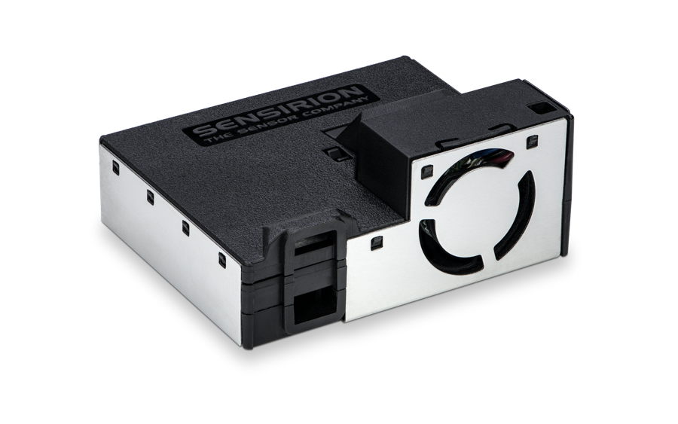
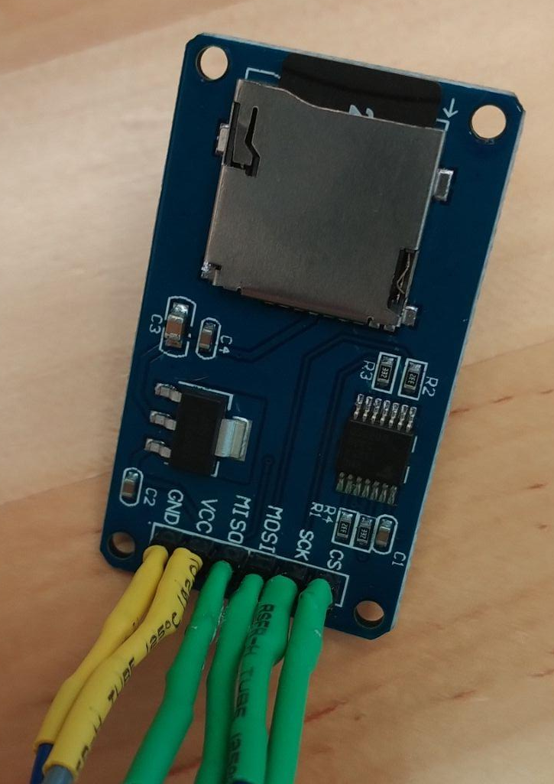
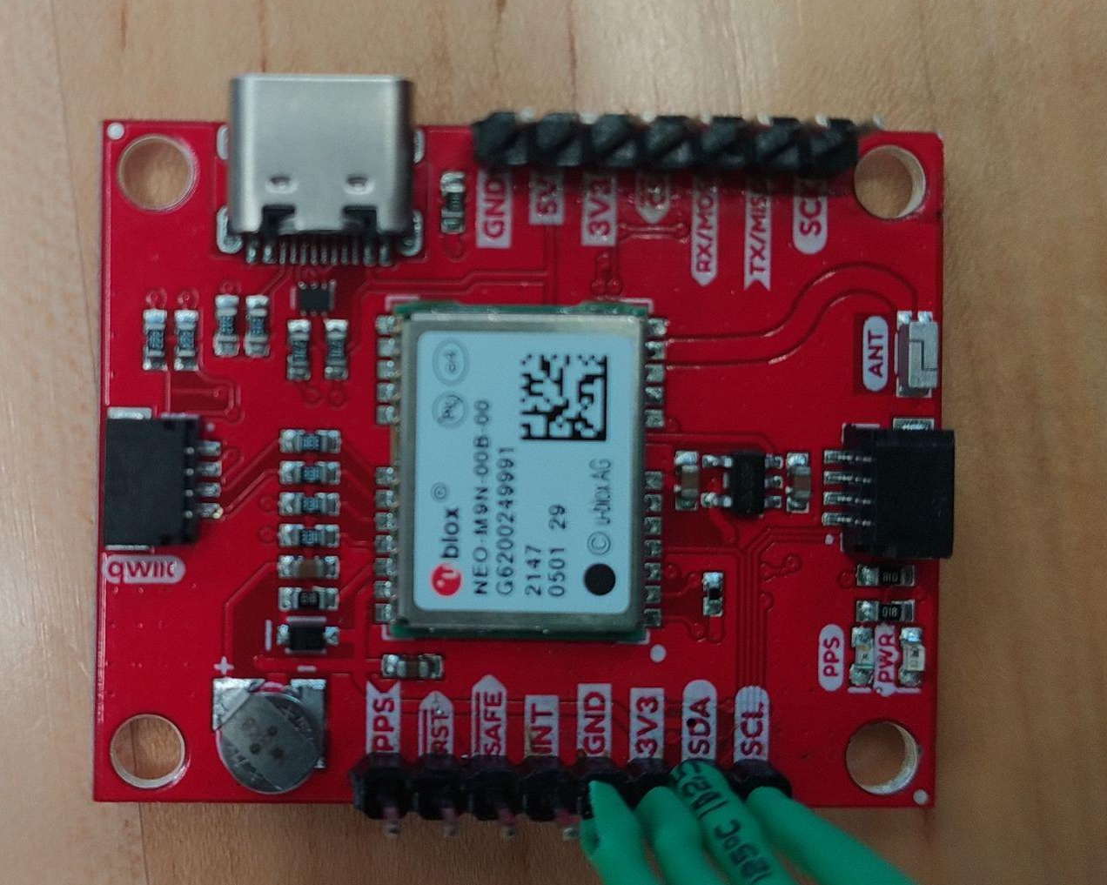
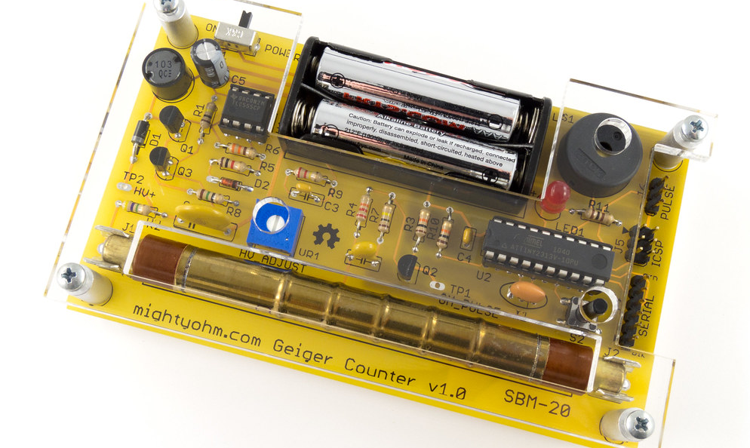
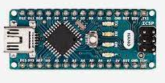
Spring Sensor Box Sensors and Components
MPRLS Pressure
SD Card Module
SEN54-SDN-T Volatile Organic Compounds & Particulate Matter
MPU-6050 Accelerometer
2 TMP36
HYT Relative Humidity
Geiger Counter
Sparkfun Neo GPS Breakout
Arduino Nano
Notes:
I (Lopez) would like to talk on this slide on the initial goals of the VOC sensor and how when combined with the geiger counter data, RH, and temp data, we could learn about cloud formation. VOCs (gasses) are secondary aerosols and can react with nitrous oxides in the atmosphere to form solids. This along with the particulate matter (measuring four different sizes of PM) can act as cloud condensation nuclei (CCN). Water vapor needs something to condense on, and the particles are some of the common possible CCN we would expect near the Phoenix Valley. Of course, for these reactions to take place there needs to be available energy to do so (that’s where the geiger counter comes in)

Slide 5
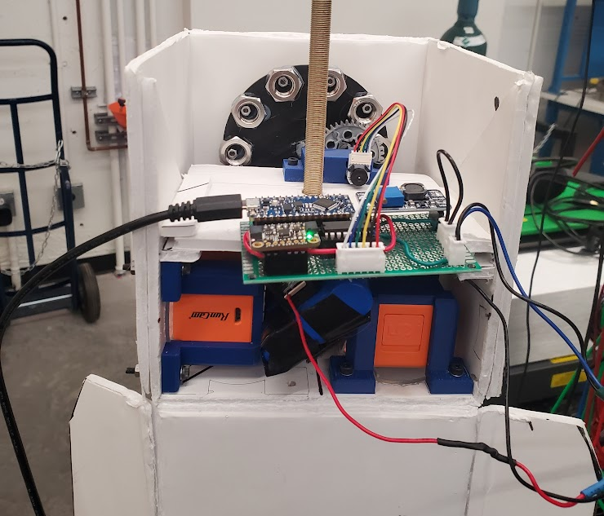
Payload Stabilization Components & Goals
Goals:
Stabilize the payload to a specified direction
Components:
Arduino Nano
MPU 6050
(2) Runcam 5
3.7V, 6600mAh Battery
DigiKey DC Motor
Notes:
As mentioned, a 12V supply performed well for powering the Nano and spinning the wheel with a motor. The components were prototyped on a breadboard then adapted to a perfboard. The components are connected using headers and connectors.

Slide 6
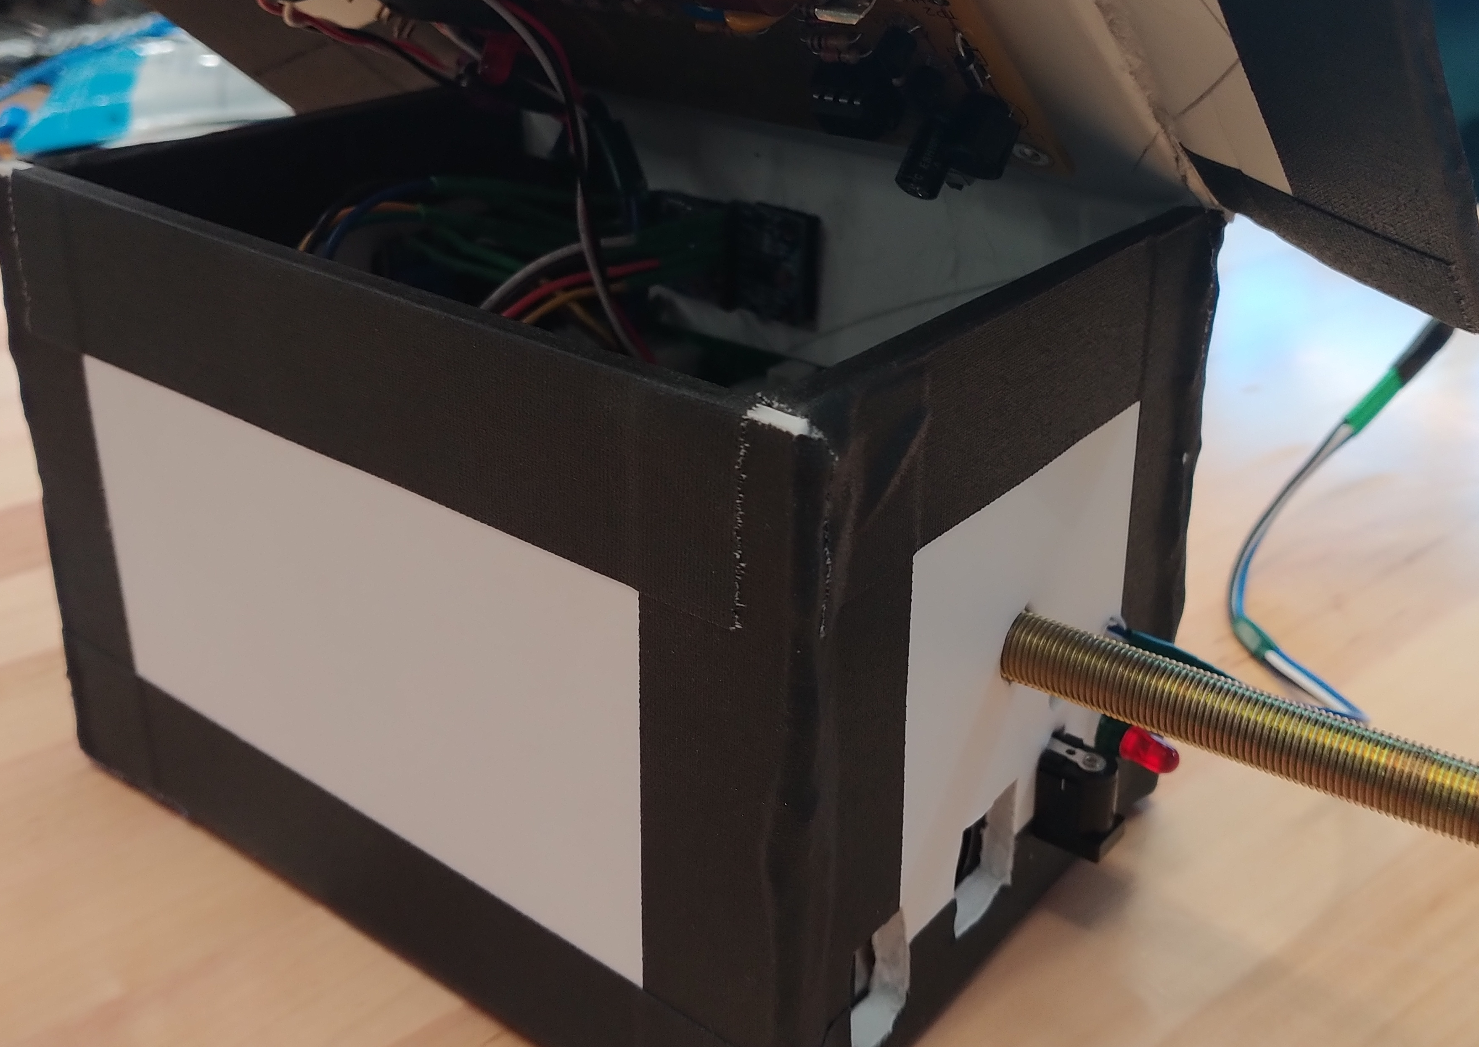
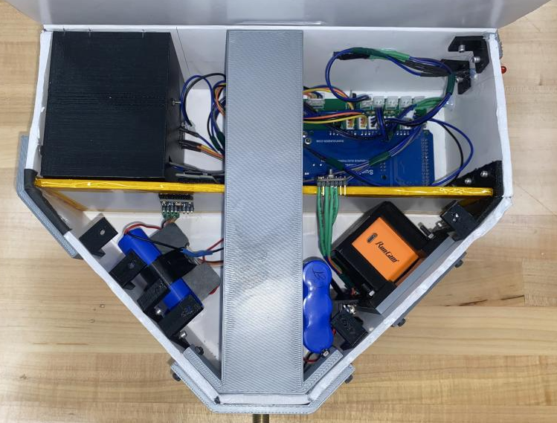
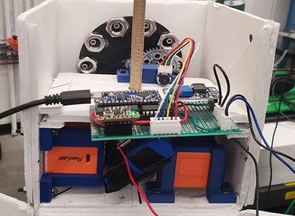
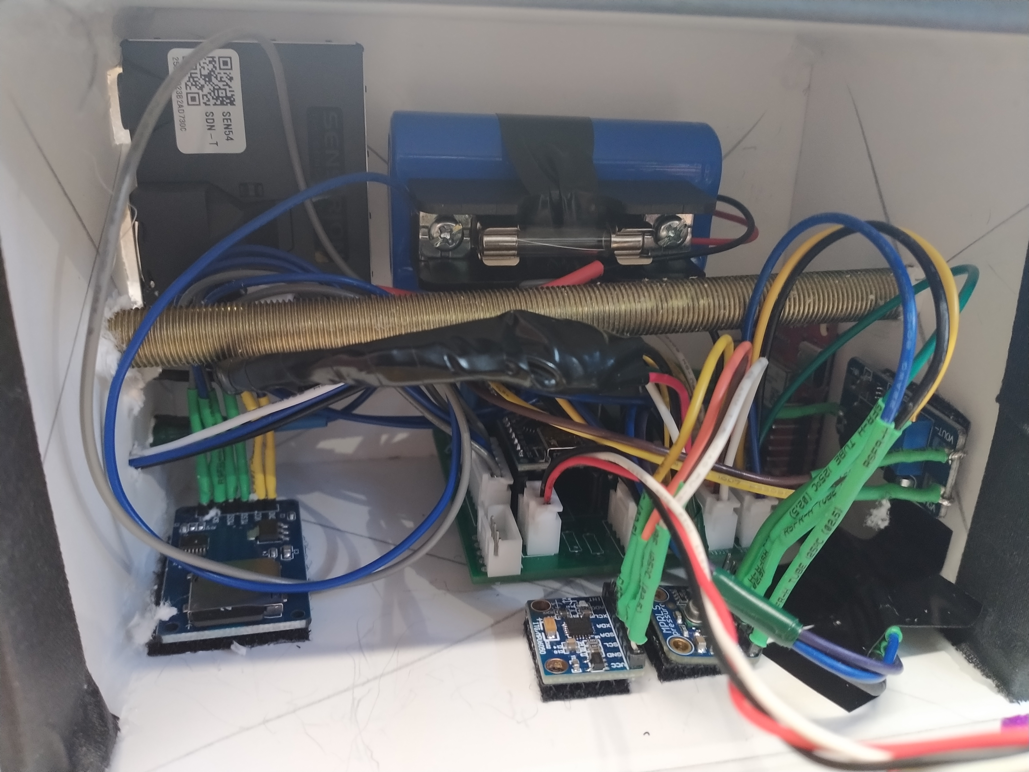
Physical Design
Materials Used:
Solid core Foam Board
Gaffer and Kapton Tape
Hot Glue
PLA
Notes:
Take circles out

Slide 7
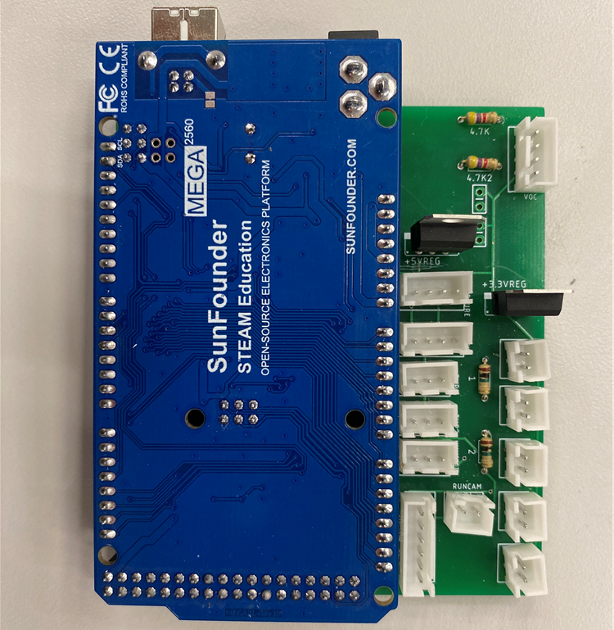
Fall Semester System Block Diagram
Payload Housing
7.4V
Battery
Switch
3.3V & 5V
Sensors
7.4V
7.4V
Power Regulation
Mega 2560
LED
PCB
5V
SD Card Module
Red = Power
Purple = Data
Camera
5V
Internal SD

Slide 8
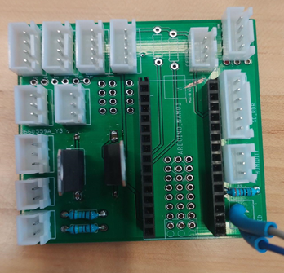
Sensor Box System Block Diagram
Battery
Switch
Boost Converter
3.3V & 5V
Sensors
3.7V
3.7V
8V
Power Regulation
Arduino Nano
8V
Red = Power
Purple = Data
PCB
5V
SD Card Module
Payload Housing

Slide 9
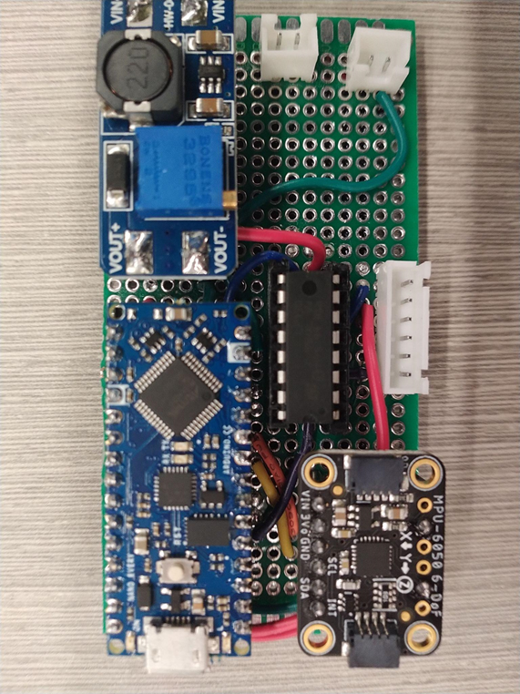
Payload Stabilization System Block Diagram
3.7V
3.7V
Battery
Switch
Boost Converter
12V
Motor Driver
DC Motor
Red = Power
Purple = Data
Arduino Nano
3.3V
MPU 6050
Payload Housing
Perfboard
Notes:
------------------------
Similar to the sensor box, a battery leads first to a boost converter with a switch in between. A 3.7V output is stepped up to 12V then the Nano provides both a 5V and 3.3V output. The MPU sensor provides gyroscopic and accelerometer data to determine which angular direction to turn the wheel. Next slide. The red arrows represents power and the purple arrows represent data.

Slide 10
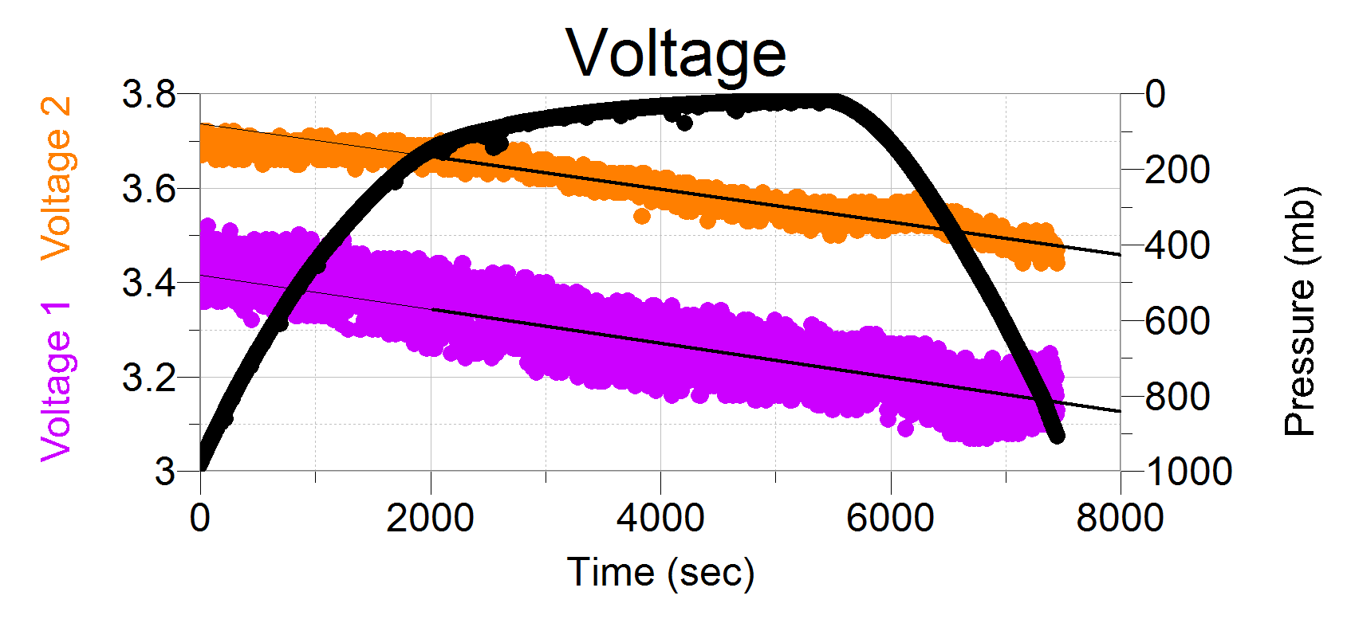
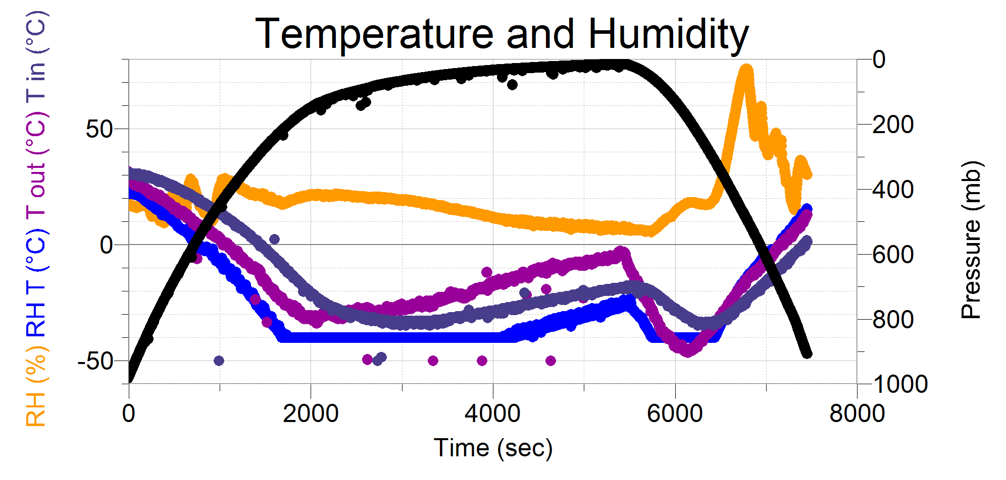
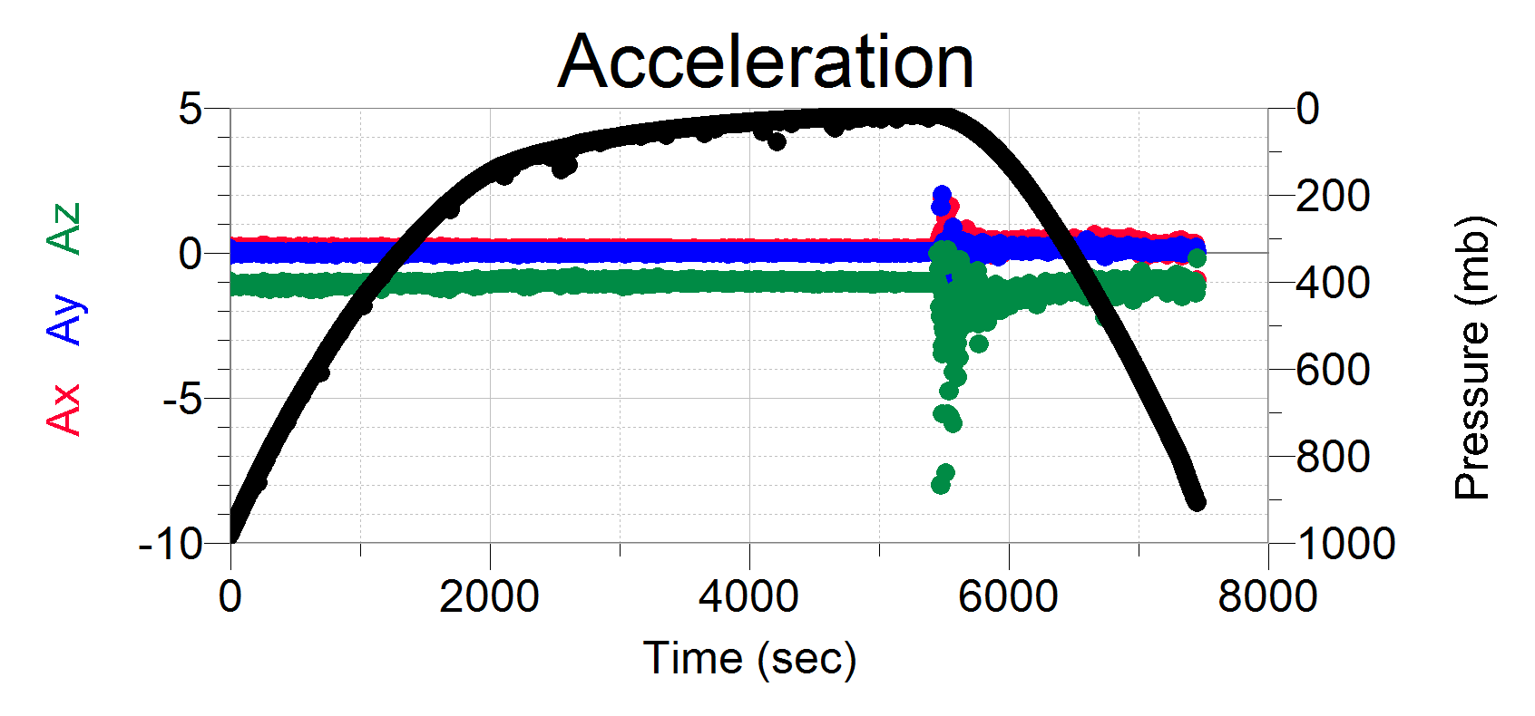
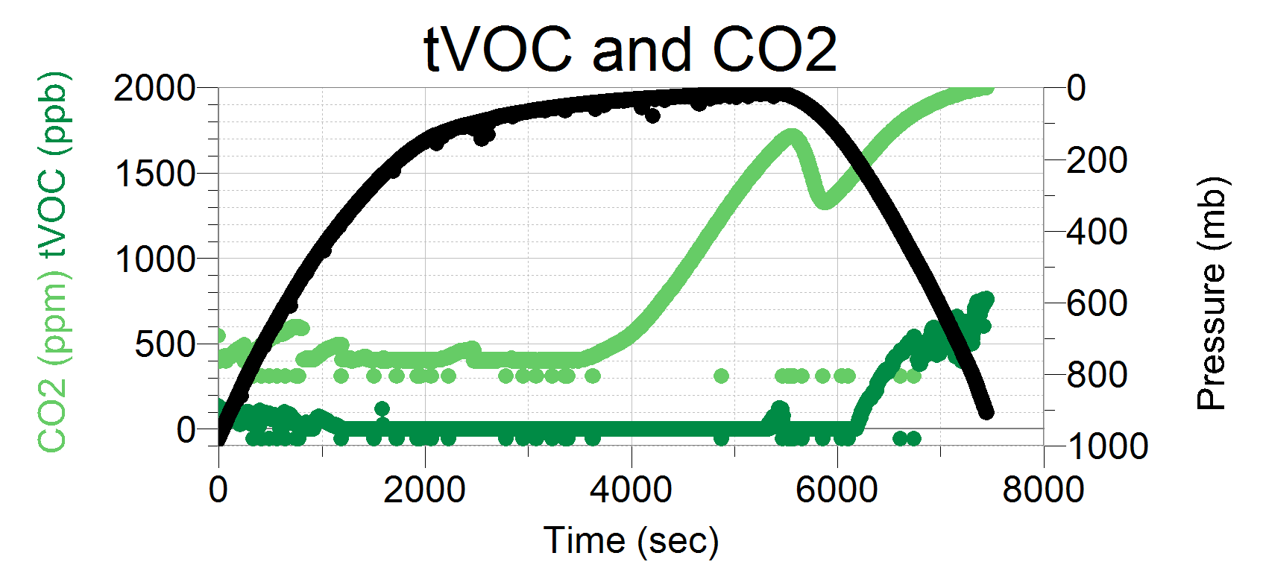
Fall Payload Data
Tropopause at: P = 137 mb t = 2064 sec
Balloon Pop at: P = 14.44 mb t = 5454 sec
Flight Length: t = 7449 sec or 124.15 mins
Notes:
Constant draw with plenty left over
Unfortunately we have invalidated

Slide 11
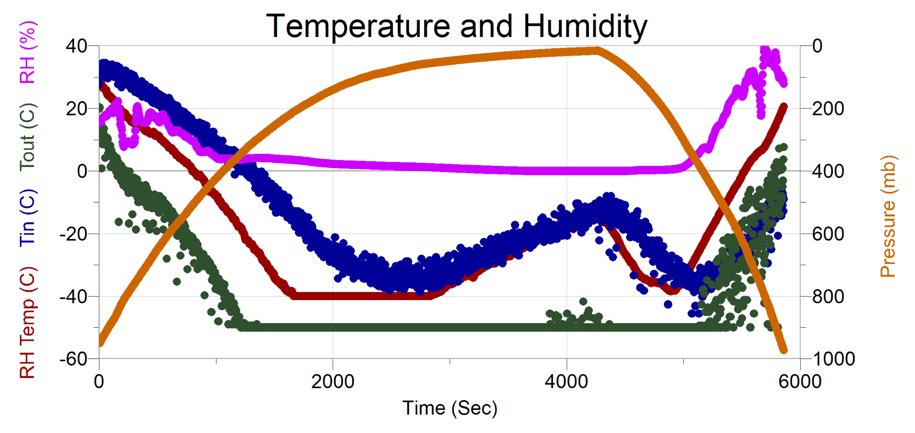
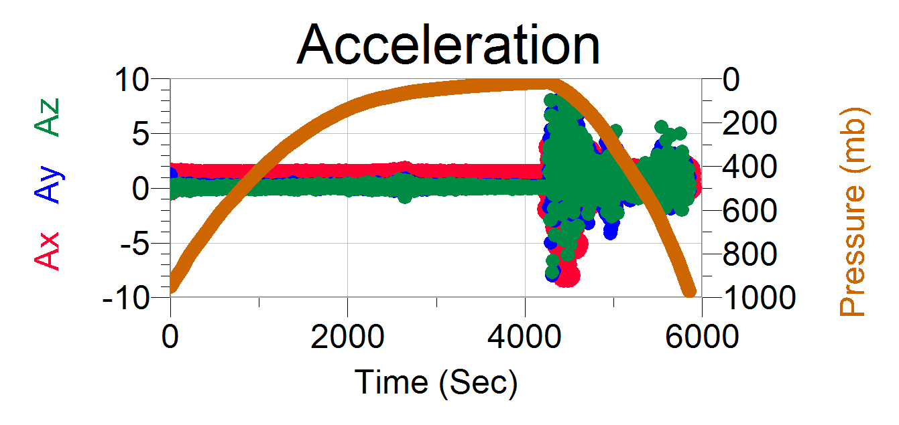
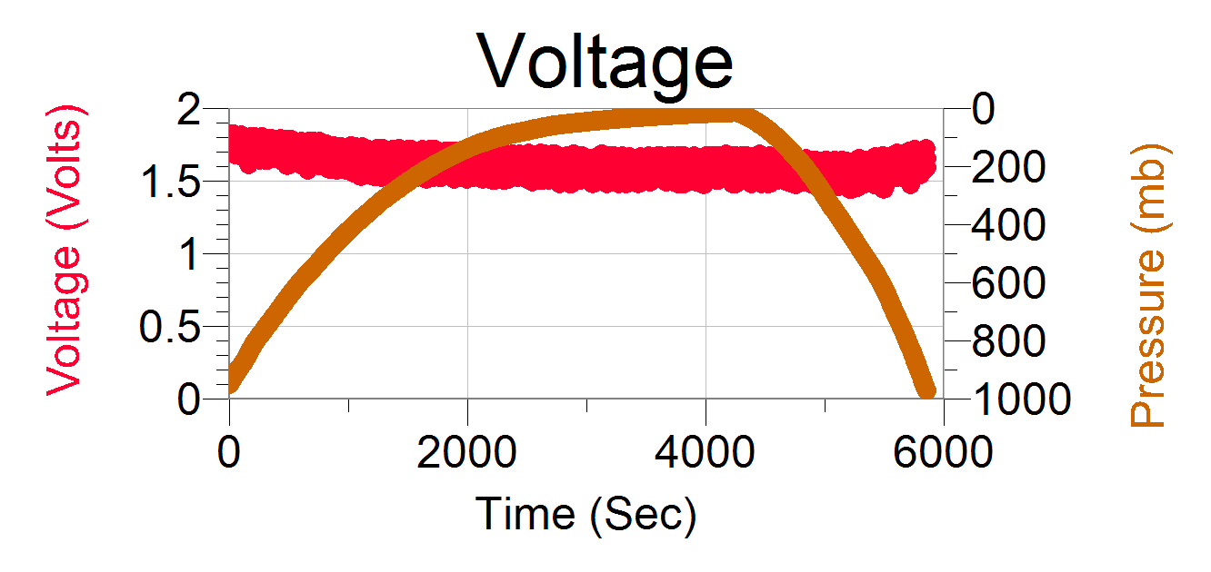
Spring Sensor Box Data
Tropopause at: P = 71 mb t = 2601 sec
Balloon Pop at P = 15.71 mb t = 4266 sec
Flight Length: t = 5859 sec or 97.65 mins
Notes:
Obtained more accurate temperature data with an improved sensor placement

Slide 12
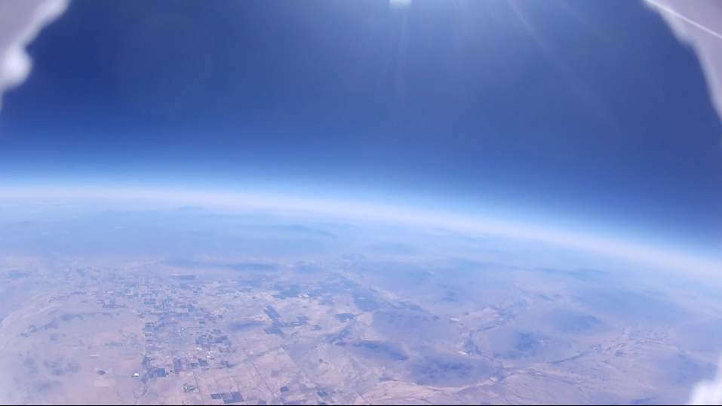
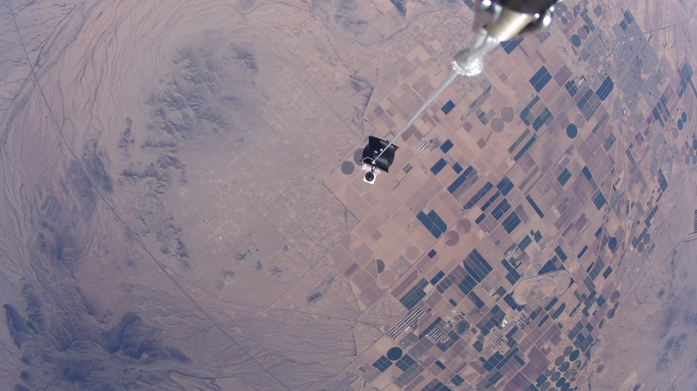
Payload Stabilization Data
Balancing wheel malfunctioned
Geiger Counter pulses was not captured
Cameras lasted for half the flight
Notes:
Anyell can talk about the geiger here, nothing else of value was obtained from this payload.
Can be multiple slides. One just for geiger, pressure and the other for images/motor.
‐-----------------------------
The Geiger Counter kit that we used was developed by an independent Electrical Engineer hobbyist. The kit uses an SBM-20 Gieger Miuller tube. Inside the tube is a noble gas that is excited by beta and gamma radiation. The Nano counts the pulses throughout the flight.
------------------------
Add camera images

Slide 13
Fall semester Problems and Solutions
Problems:
VOC & CO2 data invalidated
Insensitive sensors
Camera at the wrong angle
No ground plane on PCB
Two batteries, too much weight
Long start up procedures
Solutions:
New VOC sensor
New placement of TMP sensor
Utilize more sensitive humidity sensor
Redesigned Camera Housing
New PCB with ground Plane
Single Battery with higher voltage
External switch

Slide 14
Spring Semester Problems & Solutions
Problems:
Payload Stabilization didn’t account for acceleration
Overloaded Arduino I2C bus
SD Card Module was sensitive to position, not initializing
GPS broke during testing
3D printed Motor Shaft broke
Solutions:
Implement PID (proportional, integral, derivative) control
Use I2C Multiplexer
Use EEPROM to save data
Ensure grounding before using sensors
Use a metal Motor Shaft

Slide 15



Acknowledgments
Interplanetary Initiative Lab
Dr. Thomas Sharp
Desiree Crawl
Professor Wayne Smith
Rick Sparber
Dr. Tim Frank
Arizona Near Space Research
Dr. Anoop Singh Grewal
For more information visit our website: http://www.asuascend.weebly.com
Thank you!

